Slide 1

BIGBEARS.IO
GIVING ASP.NET WEBSITE VISIBILITY WITH REALTIME METRICS
MAHASAK PIJITTUM
BEARCHITECT
BIGBEARS.IO
DATE: 2016 - 08 - 14
© 2016 created by norbor

Slide 2

MAHASAK PIJITTUM
BEARCHITECT @ BigBears.IO
Senior Software Engineer @ Agoda
Chief Party Officer @ ตุ่นนินจา
พ่อบ้านใจกล้า @ Home
ป๋า…
BIGBEARS.IO

Slide 3
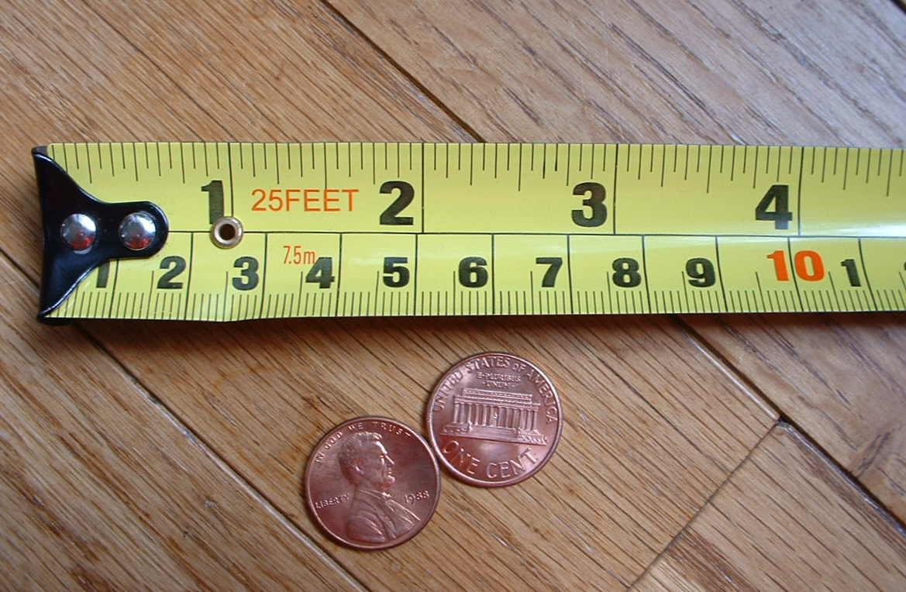
Why Measurement
Image credit: https://en.wikipedia.org/wiki/Measurement
BIGBEARS.IO

Slide 4
TRACK SUCCESS
Track your growth and identify your challenges
IMPROVE
You can’t improve what you can’t measure
SET EXPECTATIONS
Where your expectation are in next 3 months
HELP DECISION
You can’t decide without information
Why Measurement
BIGBEARS.IO

Slide 5

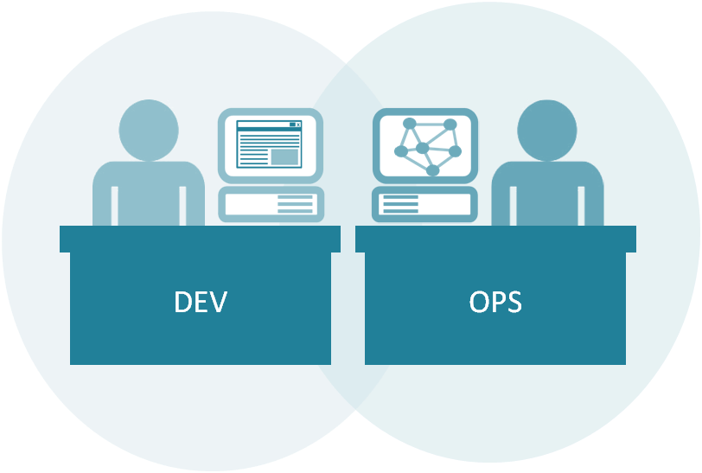

Who Loves Measurement
BIGBEARS.IO

Slide 6
Data-Driven
Strategy
Concepts
Experiment
Build
Feedback
Pivot/Perservere
Loops
Measure
Learn
Analyze
BIGBEARS.IO

Slide 7
Information that represent “data point” for each point in time
Time Series Database
BIGBEARS.IO
© 2016 created by norbor

Slide 8

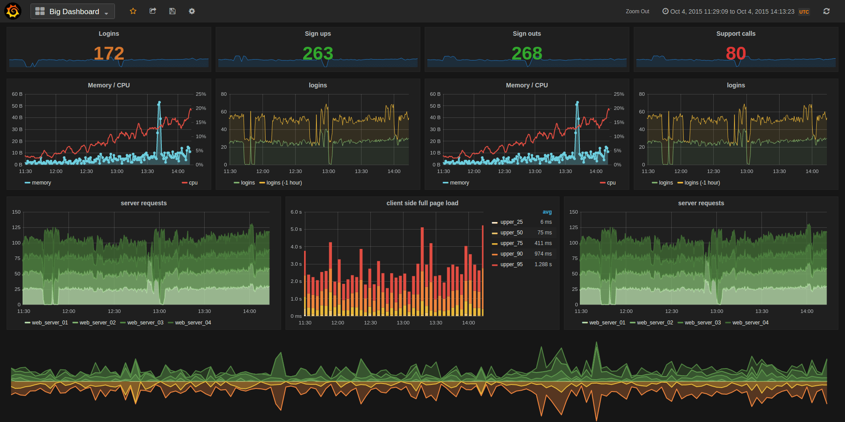
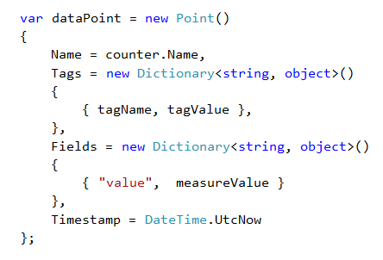
Time Series Database
Grafana
InfluxDB
Metrics/Data Point
ElasticSearch
Prometheus
Graphite
What you need
BIGBEARS.IO
© 2016 created by norbor

Slide 9
NuGet Packages
Metrics.Net
https://github.com/Recognos/Metrics.NET
Install-Package Metrics.NET
InfluxData.Net
https://github.com/pootzko/InfluxData.Net
Install-Package InfluxData.Net
What you need
BIGBEARS.IO
© 2016 created by norbor

Slide 10
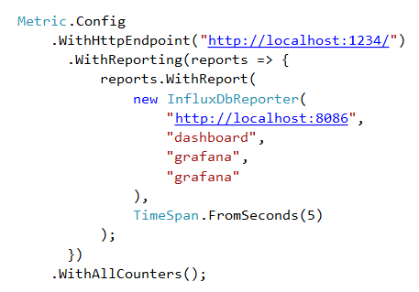
<- Visualization (Not for production)
<- Data Point Reporter
<- Reporting Interval
<- Measurement(s) to report
How to Measure
BIGBEARS.IO
© 2016 created by norbor

Slide 11
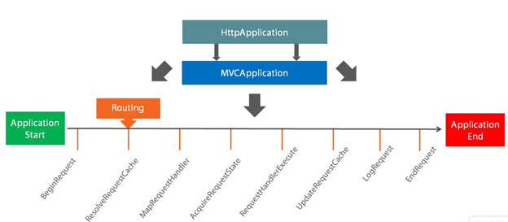
Metric Setup !!!
How to Measure
BIGBEARS.IO
© 2016 created by norbor

Slide 12
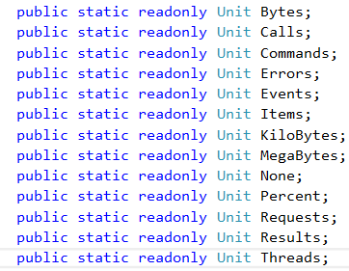
Metric Type
Metric Variable
Metric Name
Measurement Unit
COUNTER
64-bit integer values that can be
incremented and decremented
METER
measures the rate at which an event occurs.
(Counter, Mean, 1/5/15 minute rates)
HISTOGRAM
measures the distribution of values and calculate
Stats(Mean, Std.Dev, Median, Percentiles)
GUAGE
represents an instantaneous value
TIMER
a histogram of the duration of a type of event
and a meter of the rate of its occurrence
How to Measure
BIGBEARS.IO
© 2016 created by norbor

Slide 13
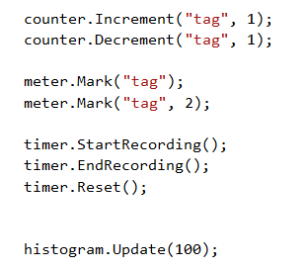
<- Counter
<- Meter
<- Timer
<- Histogram
How to Measure
BIGBEARS.IO
© 2016 created by norbor

Slide 14
Where to measure
BIGBEARS.IO
© 2016 created by norbor

Slide 15
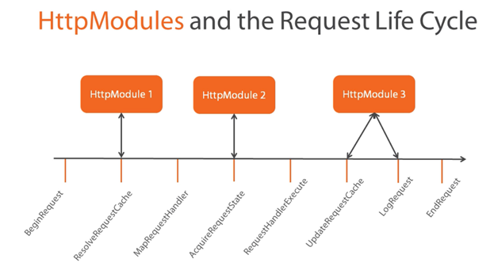
Where to measure
BIGBEARS.IO
© 2016 created by norbor

Slide 16
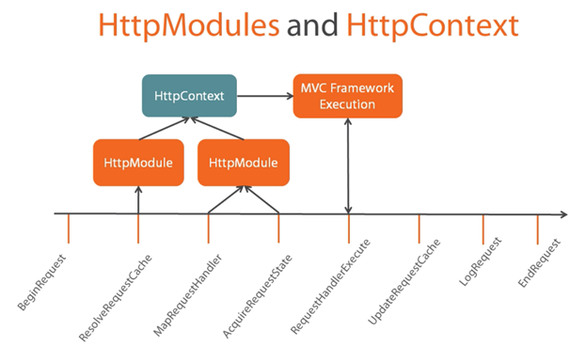
Where to measure
BIGBEARS.IO
© 2016 created by norbor

Slide 17
Where to measure
BIGBEARS.IO
© 2016 created by norbor

Slide 18
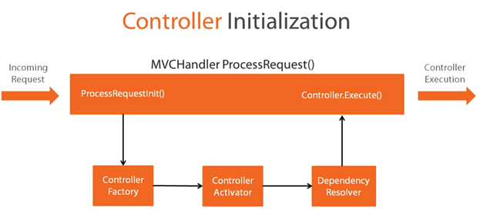
Where to measure
BIGBEARS.IO
© 2016 created by norbor

Slide 19
<- Measurement Name
<- Tags and its values
<- Fields and its values
<- Point of time
How to Report
BIGBEARS.IO
© 2016 created by norbor

Slide 20
<- Measurement Name
<- Tags and its values
<- Fields and its values
<- Point of time
How to Report
BIGBEARS.IO
© 2016 created by norbor

Slide 21
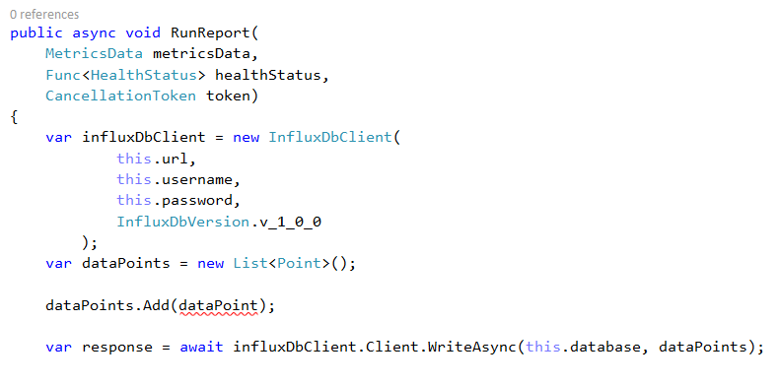
<- Custom Reporter
<- Connect to InfluxDb
<- Collect Data points
<- Send to InfluxDb
How to Report
BIGBEARS.IO
© 2016 created by norbor

Slide 22
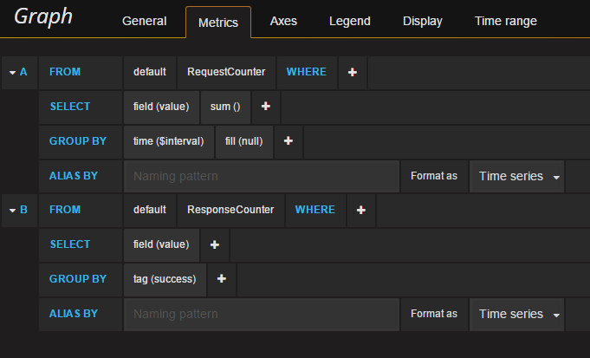
<- Measurement Name
<- Fields and aggregation
<- Tags and its values
<- Alias
How to use Metrics
BIGBEARS.IO
© 2016 created by norbor

Slide 23
How to use Metrics
BIGBEARS.IO
© 2016 created by norbor

Slide 24
DEMONSTRATION
https://github.com/bigbearsio/GrafanaDemo
© 2016 created by norbor

Slide 25
Logo #2
BIGBEARS.IO
© 2016 created by norbor

